Slide 1

CS 533 INTRO TO DATA SCIENCE
Michael Ekstrand

Slide 2
VARIABLES, OBSERVATIONS, AND TYPES

Slide 3

Learning Outcomes
Know the relationship between Pandas structures and statistical variables
Identify the type of a statistical variable
Photo by Fabio Santaniello Bruun on Unsplash

Slide 4
Data Pipeline
Things
Phenomena / Experiment
“Raw” Data
Answers
Inferences
Data Set

Slide 5
Observations
An observation (sometimes called a sample)
Of the values of one or more variables
Pertaining to a single object/instance
Species | Island | BillLength | BillDepth | FlipLength | BodyMass | Sex
Adelie | Torgersen | 39.1 | 18.7 | 181 | 3750 | M
Adelie | Torgersen | 39.5 | 17.4 | 186 | 3800 | F
Adelie | Torgersen | 40.3 | 18 | 195 | 3250 | F
Stored in Pandas as a DataFrame
Variables are columns
Data: Palmer Penguins

Slide 6
Penguin Variables
Species: penguin species (Adelie, Gentoo, Chinstrap)
Island: island measured (3 options)
BillLength: length of bill (mm)
BillDepth: depth of bill (mm)
FlipLength: length of flipper (mm)
BodyMass: penguin body mass (g)
Sex: penguin sex (M or F)
Each about one penguin

Slide 7
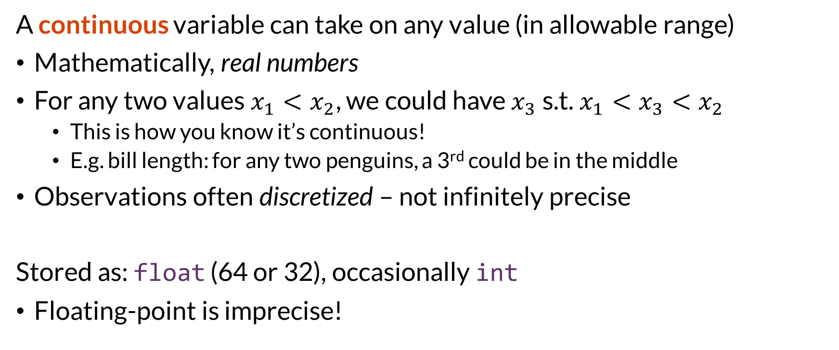
Continuous Variables
A continuous variable can take on any value (in allowable range)
Mathematically, real numbers
For any two values $x_{1}<x_{2}$, we could have $x_{3}$ s.t. $x_{1}<x_{3}<x_{2}$
This is how you know it’s continuous!
E.g. bill length: for any two penguins, a 3rd could be in the middle
Observations often discretized – not infinitely precise
Stored as: float (64 or 32), occasionally int
Floating-point is imprecise!

Slide 8
Discrete Variables
A discrete variable takes on distinct values
Can have values with no intermediates
Might not even have order
Basically all other types of data!
Many types (next slides)
Stored as: lots of things

Slide 9
Integer
Integers are discrete
Counts, etc.
Order (4 < 5)
Example: number of penguins measured
Often treated continuously, to e.g. compute means
Average number of cats per cat-owning household (1.8)¹
Stored as: int, sometimes float
¹ From American Veterinary Medical Association U.S. Pet Ownership Statistics

Slide 10
Categorical
Variable that takes on one of a fixed set of unordered values
Can compare for equality
Cannot sort or do arithmetic
Can sort for convenience, but reflects convention, not meaning
Example: species (Adelie, Gentoo, Chinstrap)
Example: user (userId in MovieLens)
Stored as: string (object), int, pandas Category

Slide 11
Boolean / Logical
Variable that is True or False
Special case of categorical
Usually stored as int or bool (which is a type of int)

Slide 12
Ordinal
Variable that takes on one of a fixed set of ordered values
Can sort, compare for inequality
Example: movie ratings (1–5 stars)
Example: class grades
Example: Likert scale (strongly agree – strongly disagree)
Really can’t do arithmetic
But we sometimes do anyway
Stored as: int, float, string (with externally-defined order), Pandas Category (in ordered mode)

Slide 13
Other Types
Time – usually continuous
Text – categorical-ish, usually converted to categorical or count
Images – matrix of ints or reals, will extract features
Money – often stored as int or float, but be very careful

Slide 14
Pandas Type Insufficient
Knowing the Python/NumPy/Pandas type is not sufficient
What is an ‘int64’?
Categorical? E.g. MovieLens userId, movieId
Continuous measured with integer precision?
Ordinal?
Logical 0/1?
Integers with missing values load as floats!

Slide 15
A Bit About Entities
What are the things being observed?
Databases: we call these entities
Sometimes straightforward: penguins
Sometimes complex and linked
Ratings
About movies
# of ratings could be a variable for a movie!

Slide 16

Wrapping Up
Many kinds of variables, broadly divided into continuous and discrete.
Conceptual variable types do not map 1:1 to Pandas types.
Need to be documented!
Photo by Omer Salom on Unsplash

